Slide 1

Unlocking Insights from Customer Data
Analyzing transactional data to guide strategic business decisions.

Slide 2


Project Overview
Customer Shopping Behavior
Goal: Uncover Insights
Spending patterns, customer segments, product preferences, subscription behavior.
Analyzed 3,900 purchases across various product categories.
Strategic Decisions
Guiding business strategy with data-driven recommendations.

Slide 3


Dataset at a Glance
Our dataset comprises 3,900 rows and 18 columns, providing a rich source of customer transaction information.
Key Features
Customer demographics (Age, Gender, Location)
Purchase details (Item, Category, Amount)
Shopping behavior (Discounts, Previous Purchases)
Note: 37 missing values in 'Review Rating' column were handled during data preparation.

Slide 4


Exploratory Data Analysis: Python Workflow
Leveraged Python for robust data preparation and cleaning, ensuring data quality for analysis.
Missing Data Handling
Data Loading & Exploration
Imputed 'Review Rating' with median values per category.
Imported with Pandas; used .info() and .describe().
Consistency & Integration
Standardization & Feature Engineering
Dropped redundant 'promo_code_used'; loaded data to PostgreSQL.
Renamed columns to snake case; created age_group and purchase_frequency_days.

Slide 5




Deep Dive: SQL Analysis
Structured analysis in PostgreSQL to answer critical business questions.
Revenue by Gender
Comparing spending across male and female customers.
High-Spending Discount Users
Identifying valuable customers despite discount use.
Top 5 Products by Rating
Highlighting customer-favorite items.
Shipping Type Comparison
Analyzing average purchase amounts by shipping method.

Slide 6

SQL Analysis: Uncovering Key Behaviors
1
Subscribers vs. Non-Subscribers
Average spend and total revenue comparison.
2
Discount-Dependent Products
Top 5 products with highest discounted purchases.
3
Customer Segmentation
New, Returning, and Loyal segments based on purchase history.
4
Top 3 Products per Category
Most purchased items within each category.
5
Repeat Buyers & Subscriptions
Correlation between purchase frequency and subscription likelihood.
6
Revenue by Age Group
Contribution of different age demographics to total revenue.

Slide 7
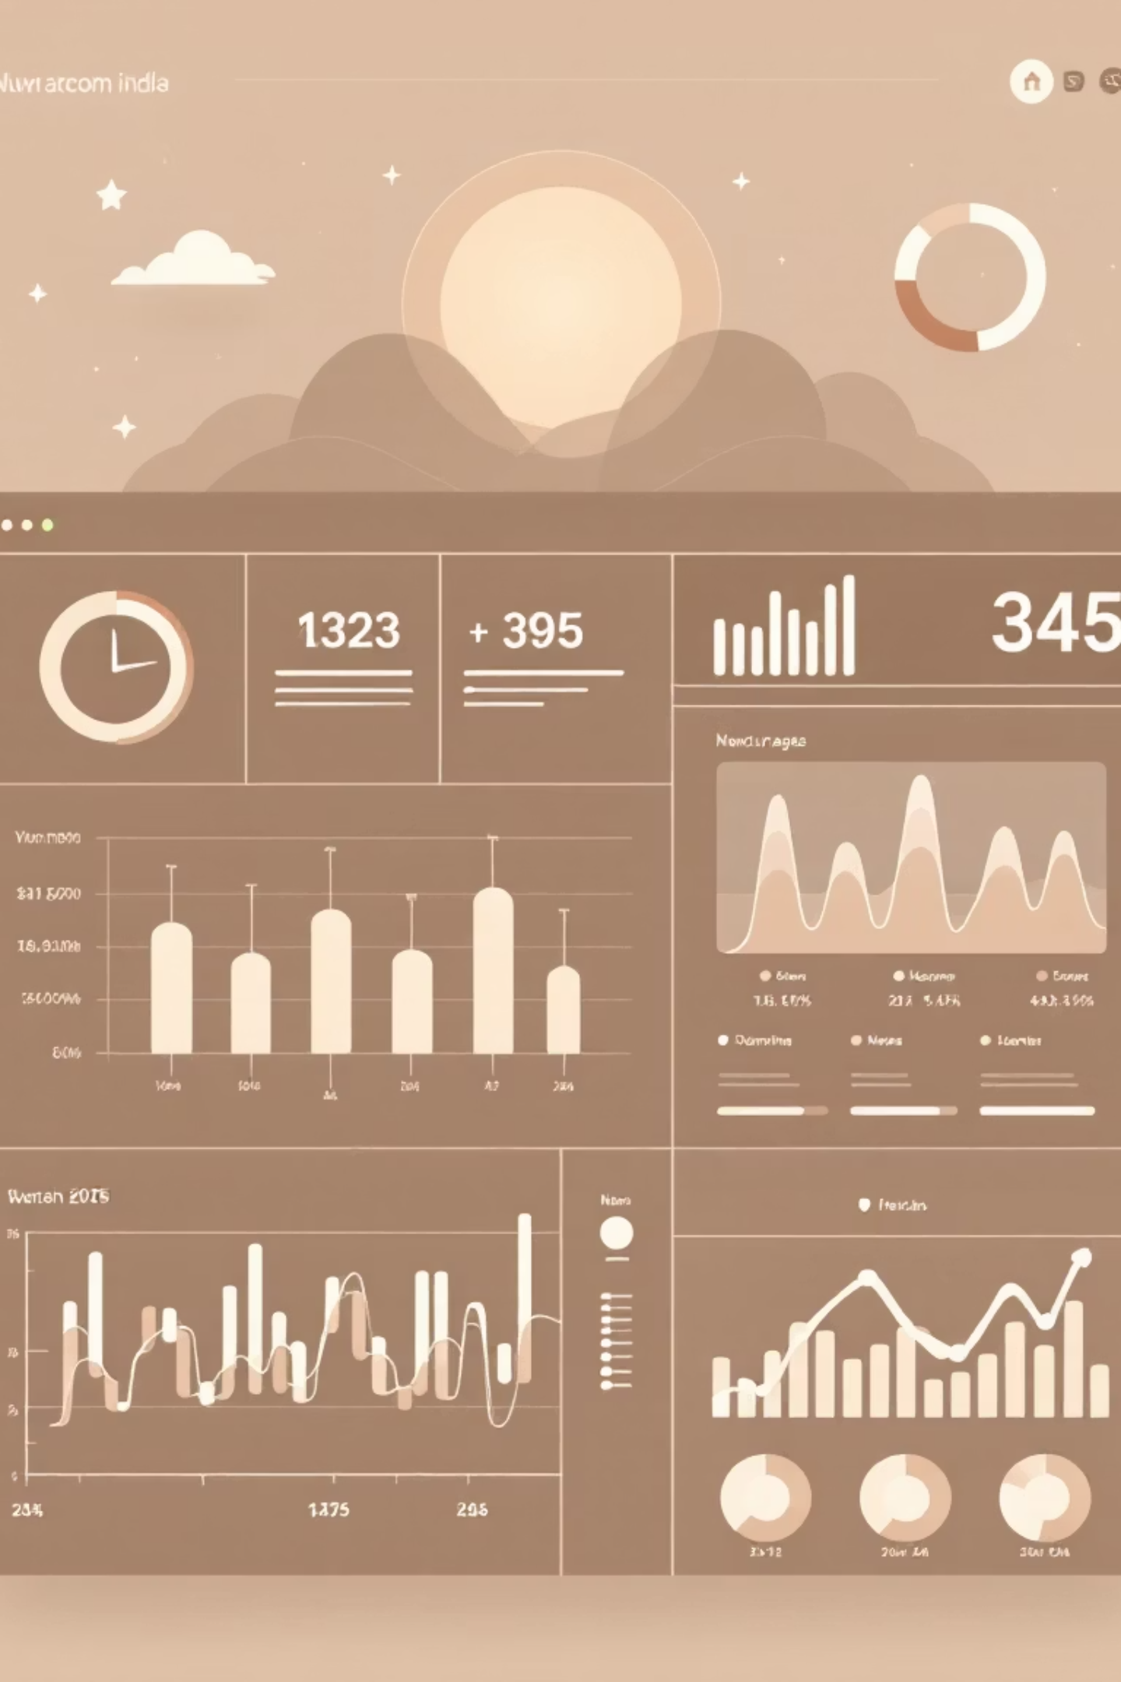
Visualizing Insights: Power BI Dashboard
Transformed complex data into actionable visual stories, providing interactive access to key metrics and trends.

Slide 8
Key Recommendations: Drive Growth
Leverage insights to optimize strategies and enhance customer value.
Boost Subscriptions
Promote exclusive benefits and value for subscribers.
Customer Loyalty Programs
Reward repeat buyers, fostering loyalty and increasing LTV.
Review Discount Policy
Optimize discount strategies for sales growth and margin control.

Slide 9

Recommendations: Enhance Product & Marketing
1
Product Positioning
Highlight top-rated and best-selling products in marketing campaigns.
2
Targeted Marketing
Focus efforts on high-revenue age groups and express-shipping users for higher ROI.

Slide 10



Impact & Next Steps
Translating analysis into tangible business success.
Strategic Iteration
Refine business strategies based on ongoing insights.
Continuous Analysis
Regularly monitor performance indicators and trends.
Maximize ROI
Optimize marketing and product efforts for sustained growth.

